Slide 1

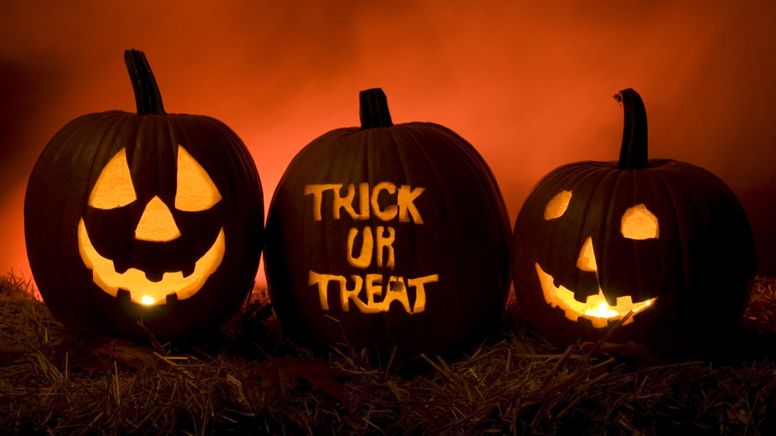
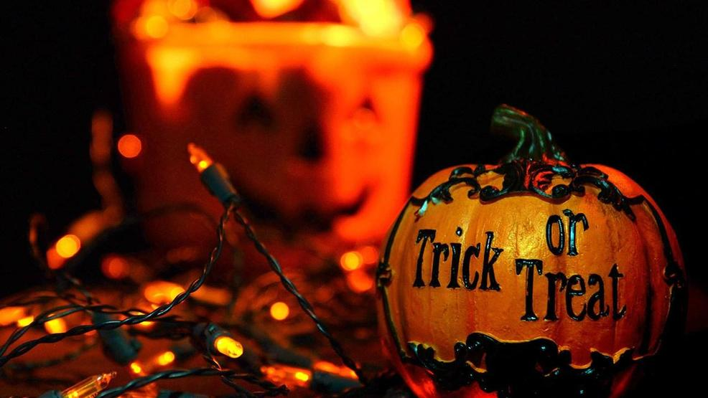
Halloween
By-Jahanvi

Slide 2

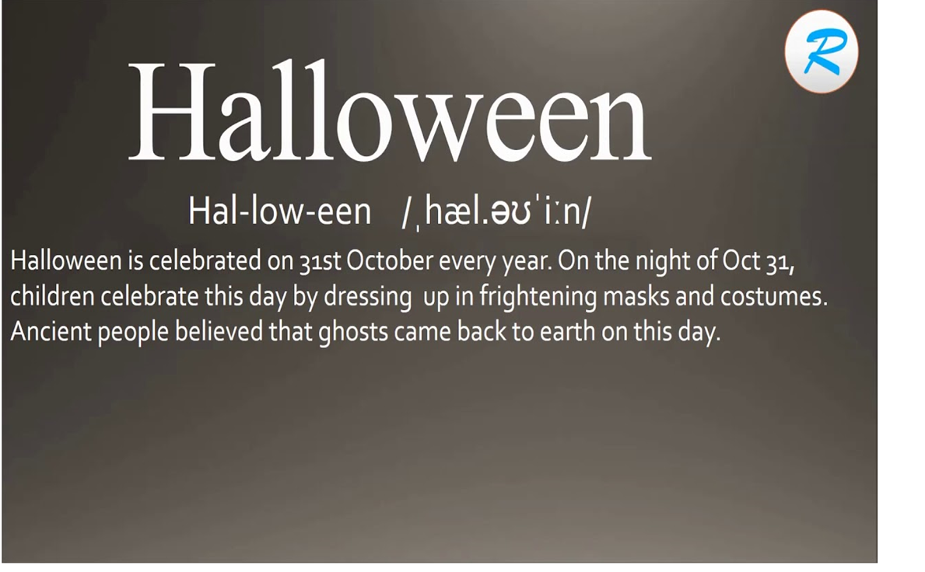
Definition
The night of 31 October, the eve of All Saints' Day, often celebrated by children dressing up in frightening masks and costumes. Halloween is thought to be associated with the Celtic festival Samhain, when ghosts and spirits were believed to be abroad.

Slide 3
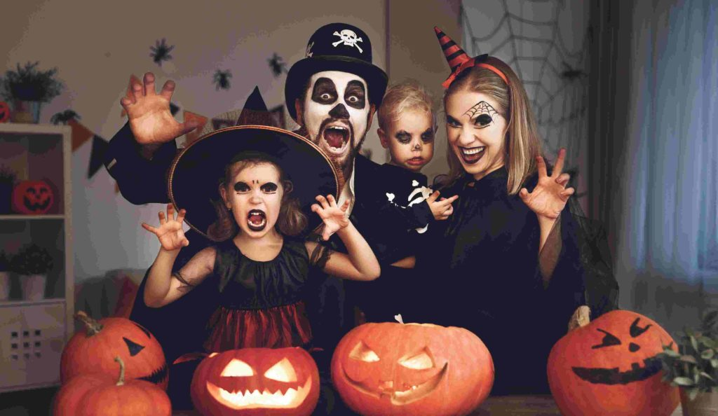
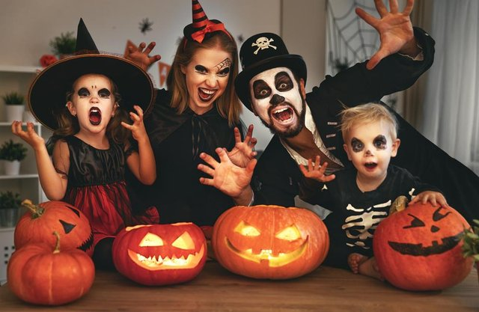
How do we celebrate “Halloween”?
People celebrate Halloween by going to church, lighting a candle, and praying. It is also celebrated by carving pumpkins, wearing scary costumes, and watching horror movies. History and significance of Halloween: Celebrated mostly in western countries, Halloween has different beliefs with respect to its origin.

Slide 4
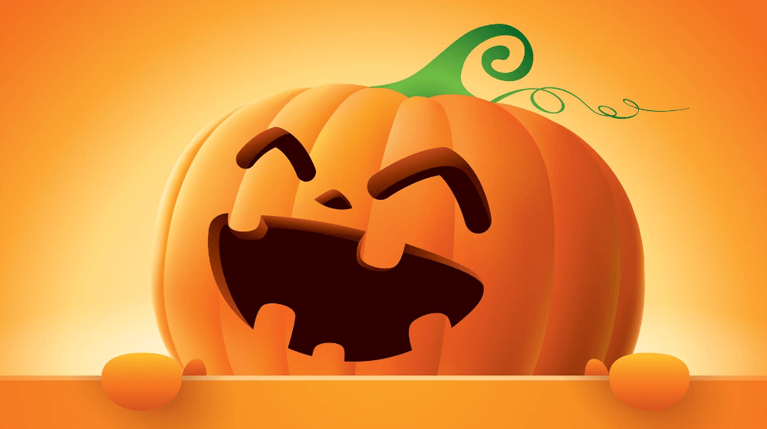
Benefit of celebrating Halloween
Social and emotional skill development. When a child joins other children in trick or treating during Halloween, that child actively experiments with emotional and social roles. This helps in the development of feelings and building self-esteem. It helps the child learn how to work with others in society.
Benefit of celebrating “Halloween

Slide 5
